Slide 1

Vendor’s News Analysis
Internship Project by Vishwajit Prakash Hegde
Mentors: Indraneel Biswas, Dhiman Bhadore
Manager: Suresh Shanmugam

Slide 2
Objective To analyze the negative sentiment associated with a vendor based on recent news articles using NLP techniques
Input
Web Scraping
Preprocessing
Summarization
Sentiment Analysis
Report Generation

Slide 3
Objective To analyze the negative sentiment associated with a vendor based on recent news articles using NLP techniques
Project Pipeline
Input
Web Scraping
Preprocessing
Summarization
Sentiment Analysis
Report Generation

Slide 4
Objective To analyze the negative sentiment associated with a vendor based on recent news articles using NLP techniques
Project Pipeline
Vendor’s name
Duration
Words to include and exclude
Input
Web Scraping
Preprocessing
Summarization
Sentiment Analysis
Report Generation

Slide 5
Objective To analyze the negative sentiment associated with a vendor based on recent news articles using NLP techniques
Project Pipeline
Input
Construct search query using input
Obtain news articles links and titles using pygooglenews api
Scrape news articles contents using newspaper library
Web Scraping
Preprocessing
Summarization
Sentiment Analysis
Report Generation

Slide 6
Objective To analyze the negative sentiment associated with a vendor based on recent news articles using NLP techniques
Project Pipeline
Input
Web Scraping
Clean the news articles by removing certain characters
Using entity recognition obtain the number of references to the vendor
Remove the articles without reference to the vendor
Preprocessing
Summarization
Sentiment Analysis
Report Generation

Slide 7
Objective To analyze the negative sentiment associated with a vendor based on recent news articles using NLP techniques
Project Pipeline
Input
Web Scraping
Preprocessing
Summarization using BERT model finetuned on news articles
Postprocessing of summary to correct spacings, punctuations and casings
Summarization
Sentiment Analysis
Report Generation

Slide 8
Objective To analyze the negative sentiment associated with a vendor based on recent news articles using NLP techniques
Project Pipeline
Input
Web Scraping
Preprocessing
Summarization
Obtain sentiment polarity for title and each sentence in the content using BERT model
Combine all the negative sentiment titles and sentences
Find entities and key-phrases associated with negative sentiment
Sentiment Analysis
Report Generation

Slide 9
Objective To analyze the negative sentiment associated with a vendor based on recent news articles using NLP techniques
Project Pipeline
Input
Web Scraping
Preprocessing
Summarization
Sentiment Analysis
Automatically generate a report containing all the analysis results
Report Generation

Slide 10
Objective To analyze the negative sentiment associated with a vendor based on recent news articles using NLP techniques
Project Pipeline
Vendor’s name
Duration
Words to include and exclude
Input
Construct search query using input
Obtain news articles links and titles using pygooglenews api
Scrape news articles contents using newspaper library
Web Scraping
Clean the news articles by removing certain characters
Using entity recognition obtain the number of references to the vendor
Remove the articles without reference to the vendor
Preprocessing
Summarization using BERT model finetuned on news articles
Postprocessing of summary to correct spacings, punctuations and casings
Summarization
Obtain sentiment polarity for title and each sentence in the content using BERT model
Combine all the negative sentiment titles and sentences
Find entities and key-phrases associated with negative sentiment
Sentiment Analysis
Automatically generate a report containing all the analysis results
Report Generation

Slide 11
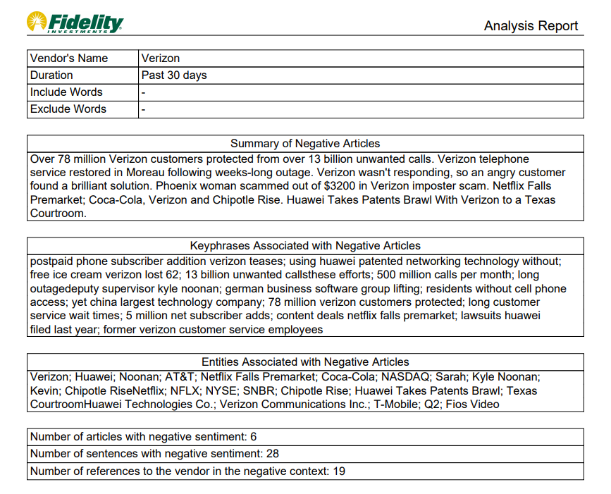
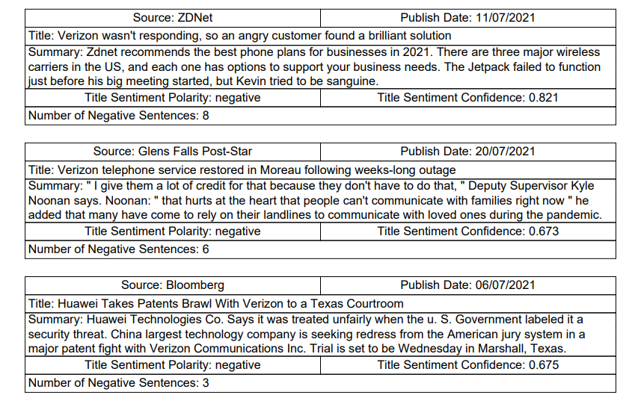
Results

Slide 12
